Slide 1

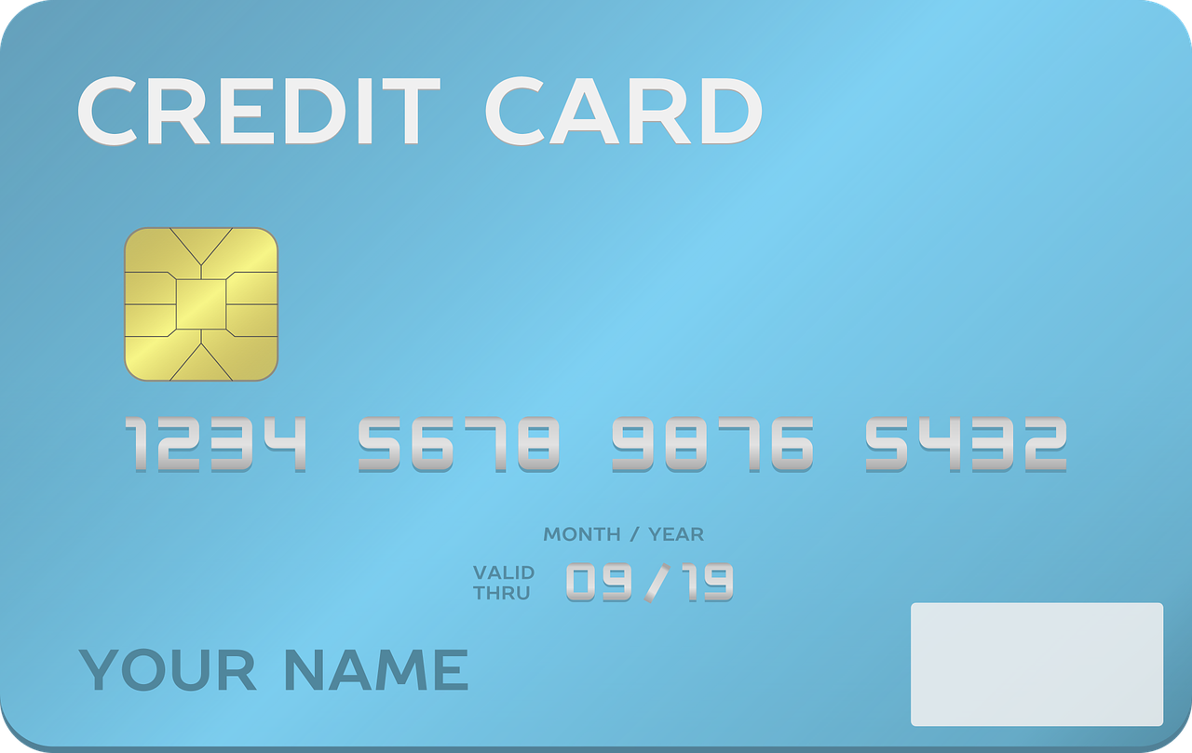
Integer Operations
+ -
x

Slide 2
Solve.
-14 + 8
Notes:
🍐 This is a Pear Deck Number Slide
🍐 To edit the type of question, go back to the "Ask Students a Question" in the Pear Deck sidebar.

Slide 3
Show how to solve the problem using two color counters.
-7 + 4
Notes:
🍐 This is a Pear Deck Drawing Slide
🍐 To edit the type of question, go back to the "Ask Students a Question" in the Pear Deck sidebar.

Slide 4
Solve.
-4(-15)
Notes:
🍐 This is a Pear Deck Number Slide
🍐 To edit the type of question, go back to the "Ask Students a Question" in the Pear Deck sidebar.

Slide 5
Drag and drop the symbol that will make the number sentence true.
-12 + 14 -14 + 12
Notes:
🍐 This is a Pear Deck Draggable™ Slide.
🍐 To edit the type of question, go back to the "Ask Students a Question" in the Pear Deck sidebar.

Slide 6
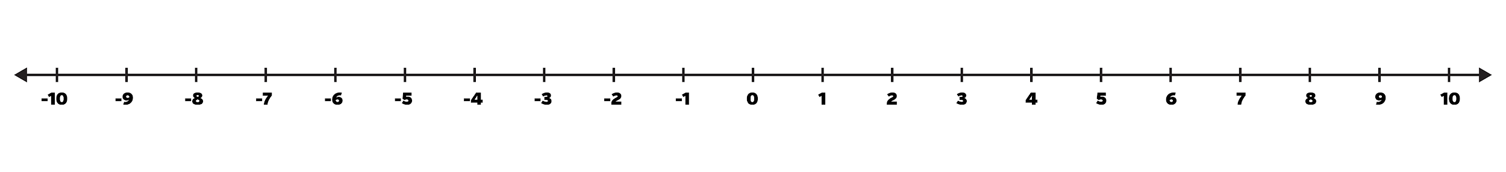
Show how to solve the problem on a number line.
-2 + 8
Notes:
🍐 This is a Pear Deck Drawing Slide
🍐 To edit the type of question, go back to the "Ask Students a Question" in the Pear Deck sidebar.

Slide 7
Solve.
-144
6
Notes:
🍐 This is a Pear Deck Number Slide
🍐 To edit the type of question, go back to the "Ask Students a Question" in the Pear Deck sidebar.

Slide 8
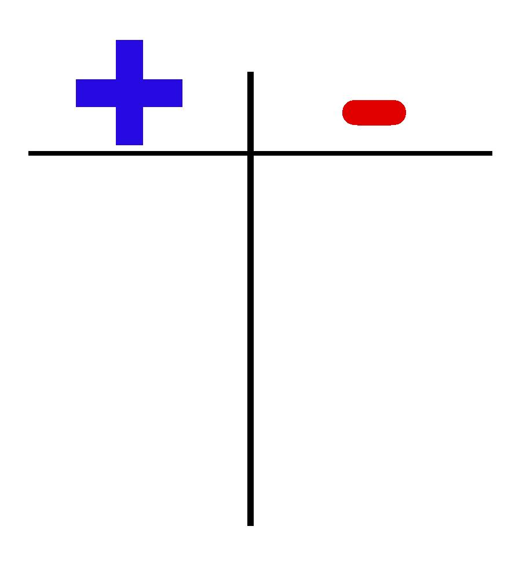
Show how to solve the problem using the scoreboard.
-15 - (-90)
answer:
Notes:
🍐 This is a Pear Deck Drawing Slide
🍐 To edit the type of question, go back to the "Ask Students a Question" in the Pear Deck sidebar.

Slide 9
Solve.
-20 - 35
Notes:
🍐 This is a Pear Deck Number Slide
🍐 To edit the type of question, go back to the "Ask Students a Question" in the Pear Deck sidebar.

Slide 10
Show how to solve the problem on a number line.
-3 + (-4)
Notes:
🍐 This is a Pear Deck Drawing Slide
🍐 To edit the type of question, go back to the "Ask Students a Question" in the Pear Deck sidebar.

Slide 11
Solve.
-84
-7
Notes:
🍐 This is a Pear Deck Number Slide
🍐 To edit the type of question, go back to the "Ask Students a Question" in the Pear Deck sidebar.

Slide 12
Show how to solve the problem using two color counters.
-5 - (-4)
Notes:
🍐 This is a Pear Deck Drawing Slide
🍐 To edit the type of question, go back to the "Ask Students a Question" in the Pear Deck sidebar.

Slide 13
Solve.
-10 - (-3)
Notes:
🍐 This is a Pear Deck Number Slide
🍐 To edit the type of question, go back to the "Ask Students a Question" in the Pear Deck sidebar.

Slide 14

The temperature in Anchorage at 6am was -20º. It was 55º warmer by noon and then dropped 70º by 10pm. What was the temperature in Anchorage at 10pm?
Notes:
🍐 This is a Pear Deck Number Slide
🍐 To edit the type of question, go back to the "Ask Students a Question" in the Pear Deck sidebar.

Slide 15
Solve.
-5(8)
Notes:
🍐 This is a Pear Deck Number Slide
🍐 To edit the type of question, go back to the "Ask Students a Question" in the Pear Deck sidebar.

Slide 16

Select the expression that best represents the situation.
The quarterback gained 8 yards on the first play, lost 12 yards on the second play, and gained 2 yards on the third play.
8 - 12 - 2
8 - 12 + 2
-8 - 12 - 2
8 - (-12) - 2
Notes:
🍐 This is a Pear Deck Draggable™ Slide.
🍐 To edit the type of question, go back to the "Ask Students a Question" in the Pear Deck sidebar.

Slide 17
Show how to solve the problem using the scoreboard.
-45 + 80
answer:
Notes:
🍐 This is a Pear Deck Drawing Slide
🍐 To edit the type of question, go back to the "Ask Students a Question" in the Pear Deck sidebar.

Slide 18
Solve.
-2(-5)(-15)
Notes:
🍐 This is a Pear Deck Number Slide
🍐 To edit the type of question, go back to the "Ask Students a Question" in the Pear Deck sidebar.

Slide 19
Put a point on the number line that represents the solution to
-5 - (-5)
Notes:
🍐 This is a Pear Deck Drawing Slide
🍐 To edit the type of question, go back to the "Ask Students a Question" in the Pear Deck sidebar.

Slide 20
Solve.
-100 - 30 - (-25) + 10
Notes:
🍐 This is a Pear Deck Number Slide
🍐 To edit the type of question, go back to the "Ask Students a Question" in the Pear Deck sidebar.

Slide 21
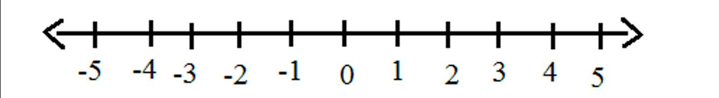
Draw lines to match the problems to their models.
-4 + 8 4 + (- 8) 8 - (-4) 8 - 4
8
4
8 4
Notes:
🍐 This is a Pear Deck Drawing Slide
🍐 To edit the type of question, go back to the "Ask Students a Question" in the Pear Deck sidebar.

Slide 22



How well did you understand this lesson?
Notes:
Temperature Check
Get a sense for how well your lesson resonated with your students, or how engaged they were.
🍐 This is a Pear Deck Draggable™ Slide.
🍐 To edit the type of question, go back to the "Ask Students a Question" in the Pear Deck sidebar.

Slide 23
Answers:
-6
-3
60
>
6
-24
75
-55
-7
12
-1
-7
-35
-40
8 - 12 + 2
35
-150
0
-95
See next slide

Slide 24
Draw lines to match the problems to their models.
-4 + 8 4 + (- 8) 8 - (-4) 8 - 4
8
4
8 4
Notes:
🍐 This is a Pear Deck Drawing Slide
🍐 To edit the type of question, go back to the "Ask Students a Question" in the Pear Deck sidebar.

